Slide 1


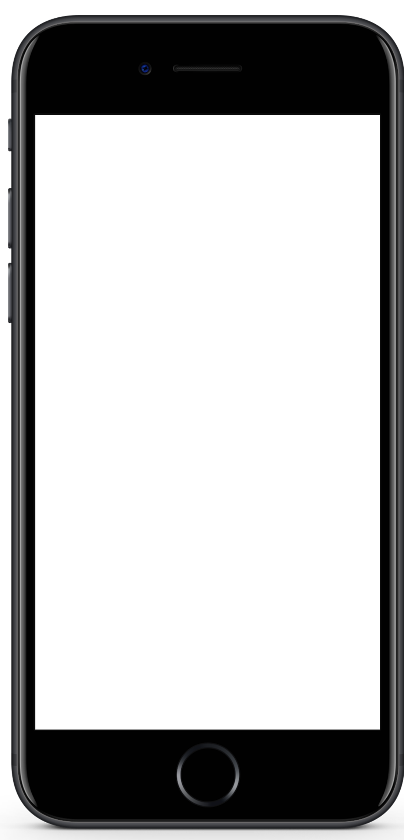

Mobile Application Development
Muhammad Ashraf Baloch

Slide 2
Key Points
Running App Process
ADB & AVD
.APK
Open Android Studio for creating first Project

Slide 3
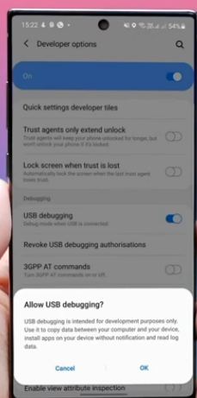
ADB
Android Debug Bridge

Slide 4
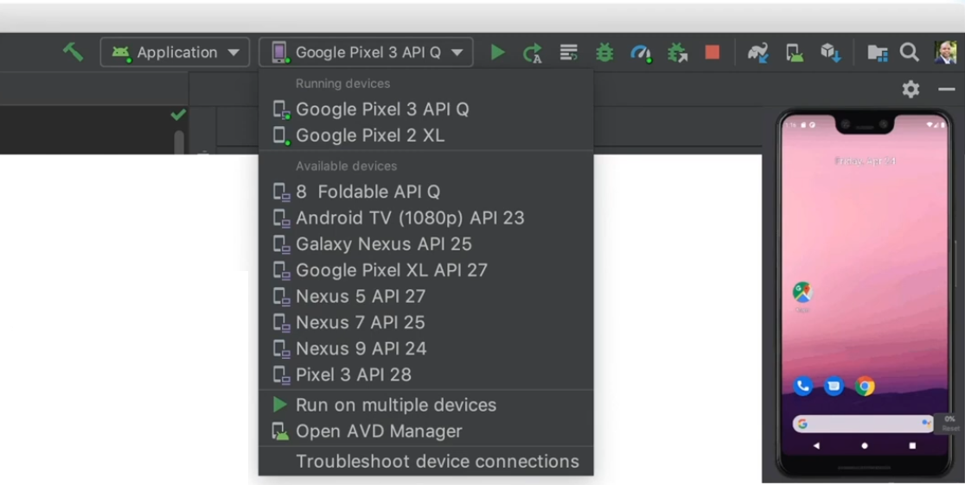
Run on Virtual Device

Slide 5
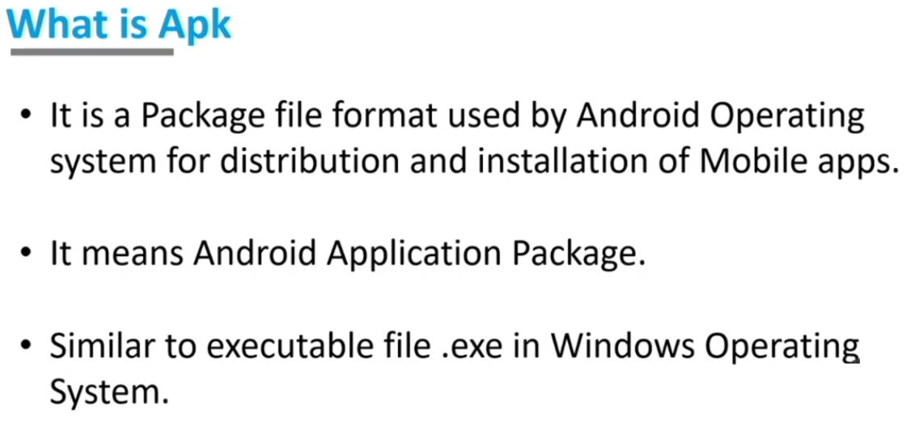

Slide 6
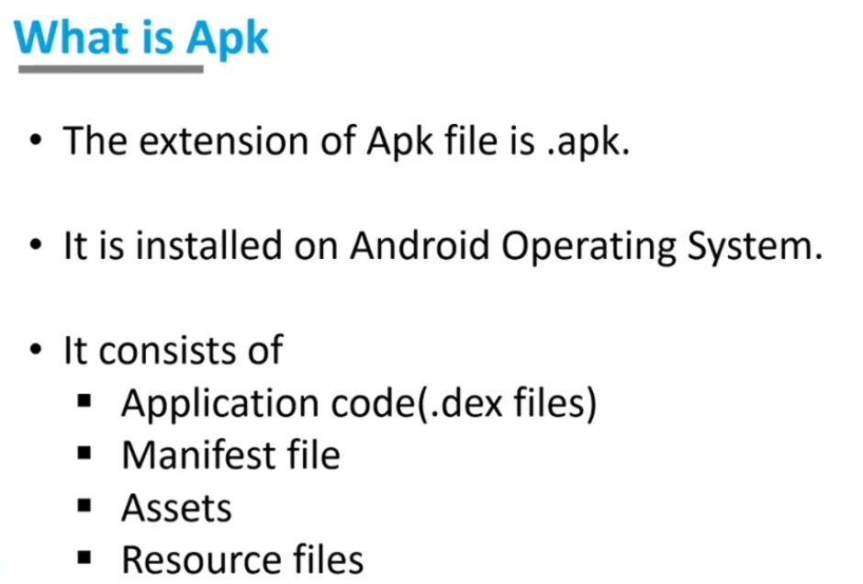

Slide 7
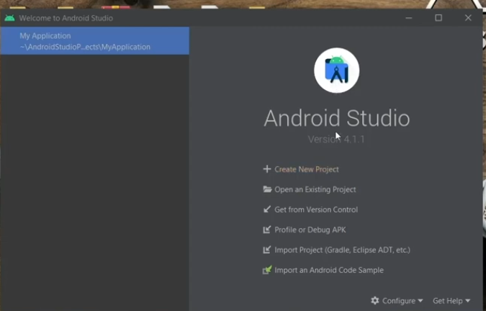
Open Android Studio

